Slide 1
Technical Exercise Presentation
Commercial Sales Analyst

Slide 2
Methodology
Data Understanding, Cleaning and Preparation (Python)
Exploratory Data Analysis & Insights (Python)
Answering Strategic Questions (SQL)
Dashboard Design (Excel)

Slide 3
Tools and Skills
Tools
Microsoft Excel
Jupyter Notebooks
MySQL Work Bench
Skills
Pivot Charts & Dashboard Design
Python
SQL

Slide 4
Data Cleaning & Preparation
Payment Plan Table
488 rows and 18 columns.
Handling Missing Values
Sales Table
194 rows and 4 columns
Handling Null values and outliers
Data Merging
Created new Revenue column

Slide 5
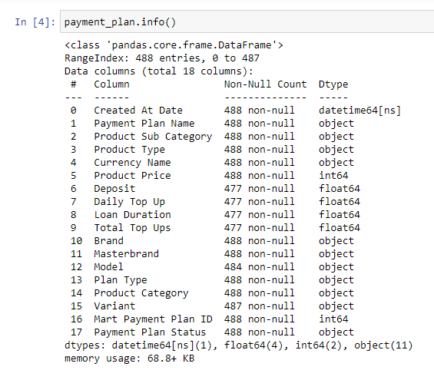
Payment Plan Table
Data Cleaning
Replaced missing values in the "Model" column with values from the "Product Sub Subcategory
Extracted variant values from the "Payment Plan” Column
Replacing the remaining null values with zero for Deposit, Daily Top Up, Loan Duration and Total Top Ups columns

Slide 6
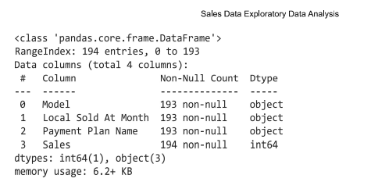
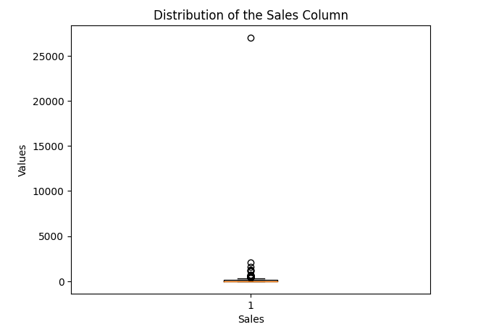
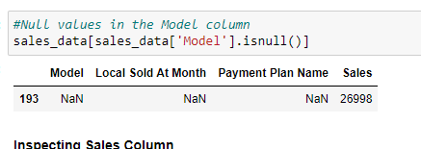
Sales Table
Data Cleaning
Tasks
Dealing with the extra row in the sales table
Additionally, the extra row has missing values and an outlier that I had to deal with.

Slide 7
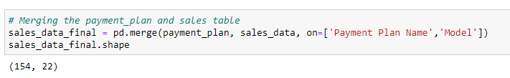

Merging Tables
A merged sales dataset with 154 rows is generated
Creating New Revenue Column
Calculated by finding the product of the Daily Top Up and Sales columns.
The code below in Python got rid of the row with missing values
sales_data.dropna(inplace = True)

Slide 8
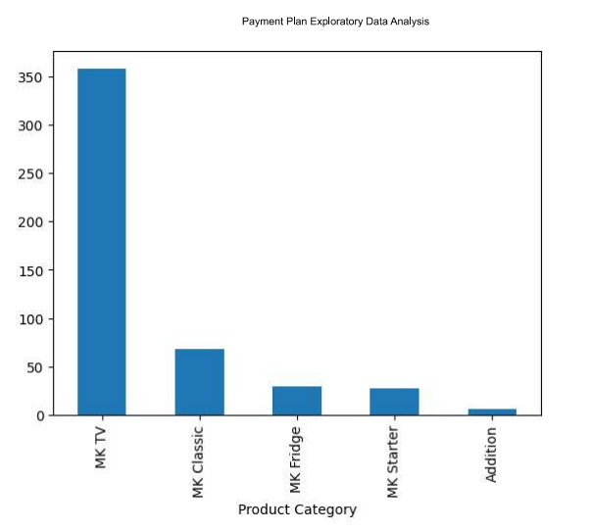
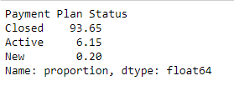
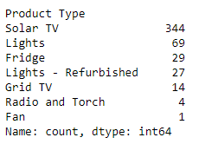
EDA & Insights
EDA
Insights
MK TV" is the most popular Product Category
Solar TV is the most popular Product
Acquisition" is the most popular Plan Type
M-KOPA 6000 is the most popular Sub Category
93.65% of the payment plans have been closed
24" TV is the most popular Variant

Slide 9
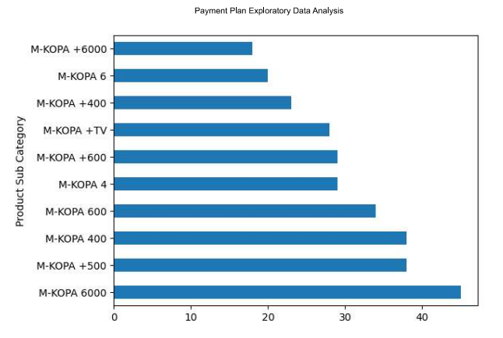
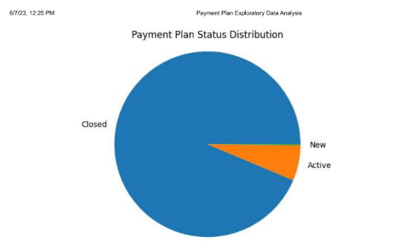
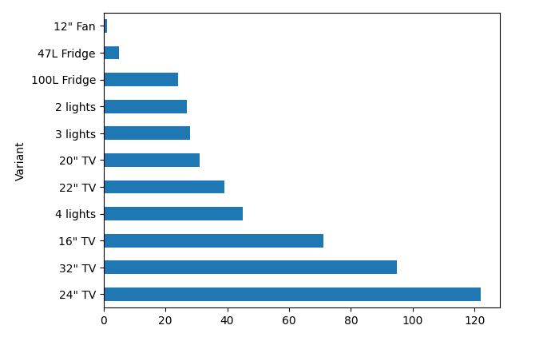
EDA & Insights

Slide 10
Dashboard Design & Answering Strategic questions
Dashboard Design and Answering strategic questions will be presented in Excel and MySQL Work Bench respectively.
Thank You.

